Slide 1
MAT256: Multiplication & Division of Fractions

Slide 2

Warm-up! Copies of Practice
This is a ½ sheet in your packet! Glue in on the right-hand side of pg. 52!
Use as your unit.
Represent the fraction 2/3.
Then draw a picture to visualize 6 copies of 2/3.
How many copies of 1/3 are shaded?
Write a multiplication sentence illustrated by your picture.
Notes:
The language we are hoping will emerge is “I see a whole cute into 3 equal pieces and I’m picturing 2 of the 1/3 pieces.

Slide 3
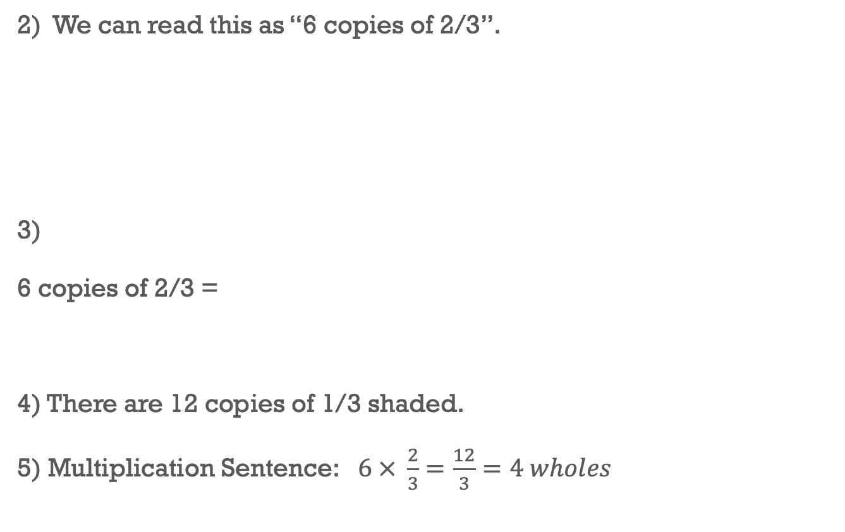
ANSWERS
Notes:
The language we are hoping will emerge is “I see a whole cut into 3 equal pieces and I’m picturing 2 of the 1/3 pieces”

Slide 4
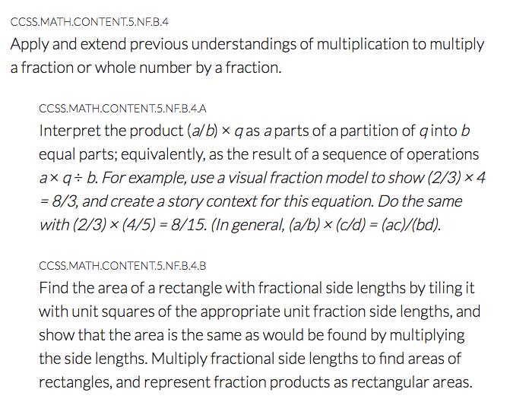
Connections to the Standards – 4th grade (Number & Operations Fractions)
http://www.corestandards.org/Math/Content/NF/

Slide 5
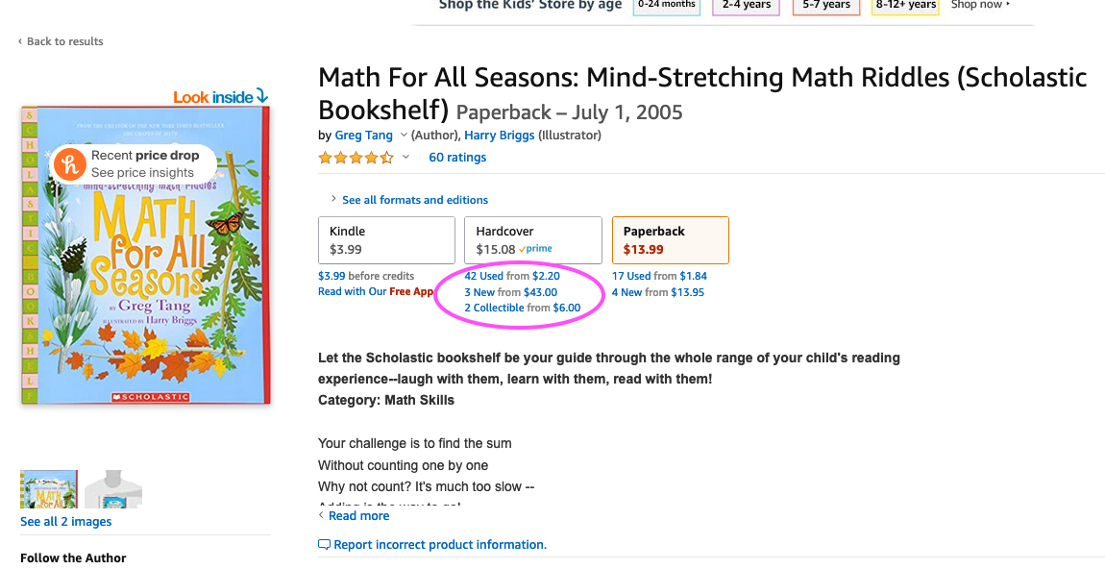
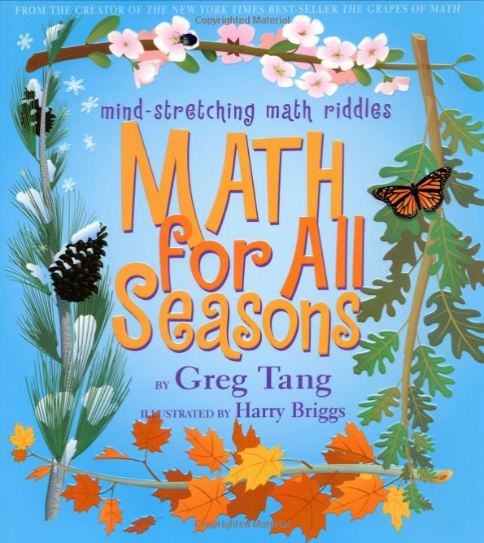
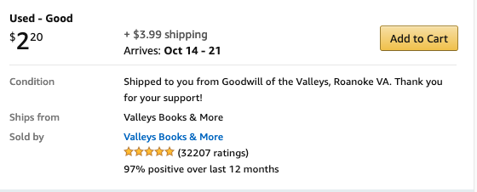
Good Books for Your Classroom!
https://www.amazon.com/Math-All-Seasons-Mind-Stretching-Scholastic/dp/0439755379/ref=sr_1_3?dchild=1&keywords=math+for+all+seasons&qid=1601912770&sr=8-3

Slide 6
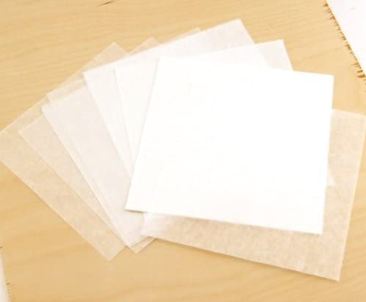

Grab your Patty Paper
Let’s make a model!!!
From your packet!

Slide 7
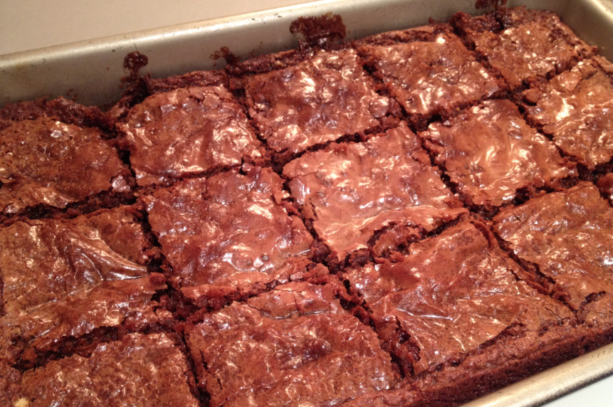
Example – Multiplying a Fraction and a Fraction – Patty Paper
You made a tray of brownies for a birthday party.
After the party ¾ of the tray is left.
You eat 1/3 of the leftovers.
How much of the original tray of brownies did you eat?
Think about what “the unit” is.
Let’s model it….with your patty paper...
Notes:
Here is where the meaning of the unit is so important.
Some students might say they ate 1/3 of the original tray. We have to try to move them towards recognizing that the 1/3 was using the leftover as the unit. We want to go back and use the original tray as the unit.
1/3 of the leftovers is actually ¼ of the original tray.

Slide 8


Example – Multiplying a Fraction and a Fraction – Patty Paper
Results
One piece of patty paper represents the original tray.
Fold the paper into fourths and shade 3 copies of ¼
This represents the leftover brownies.
Fold your paper so only the shaded part is showing.
I have now shaded ¾!
Let’s fold this part back since it’s gone...
Notes:
Here is where the meaning of the unit is so important.
Some students might say they ate 1/3 of the original tray. We have to try to move them towards recognizing that the 1/3 was using the leftover as the unit. We want to go back and use the original tray as the unit.
1/3 of the leftovers is actually ¼ of the original tray.

Slide 9
Example – Multiplying a Fraction and a Fraction – Patty Paper
Results
3. Now, rotate your paper 90 degrees.
4. Fold your paper into thirds.
We ate ⅓ of the leftovers.
Shade this amount with a darker color!
Notes:
Here is where the meaning of the unit is so important.
Some students might say they ate 1/3 of the original tray. We have to try to move them towards recognizing that the 1/3 was using the leftover as the unit. We want to go back and use the original tray as the unit.
1/3 of the leftovers is actually ¼ of the original tray.

Slide 10

Example – Multiplying a Fraction and a Fraction – Patty Paper
Results
Now we want to go back & see this dark shaded area in terms of the entire tray of brownies
Rename the dark shaded area using the entire patty paper as our unit.
Remember, the ENTIRE pan of brownies was our unit!
We need to figure out what this piece is called...
Now, I see there were 12 brownies so this piece is 1/12 of the entire pan!
Let’s unfold this again to see how many brownies were ORIGINALLY in our pan….
Notes:
Here is where the meaning of the unit is so important.
Some students might say they ate 1/3 of the original tray. We have to try to move them towards recognizing that the 1/3 was using the leftover as the unit. We want to go back and use the original tray as the unit.
1/3 of the leftovers is actually ¼ of the original tray.

Slide 11

Example – Multiplying a Fraction and a Fraction – Patty Paper
I see 3 copies of 1/12… so 3/12 or ¼ is my final answer!
Notes:
Here is where the meaning of the unit is so important.
Some students might say they ate 1/3 of the original tray. We have to try to move them towards recognizing that the 1/3 was using the leftover as the unit. We want to go back and use the original tray as the unit.
1/3 of the leftovers is actually ¼ of the original tray.

Slide 12
Example – Multiplying a Fraction and a Fraction – Patty Paper
Results
Now write out the multiplication sentence
¾ x ⅓ = 3/12 or 1/4
Notes:
Here is where the meaning of the unit is so important.
Some students might say they ate 1/3 of the original tray. We have to try to move them towards recognizing that the 1/3 was using the leftover as the unit. We want to go back and use the original tray as the unit.
1/3 of the leftovers is actually ¼ of the original tray.

Slide 13
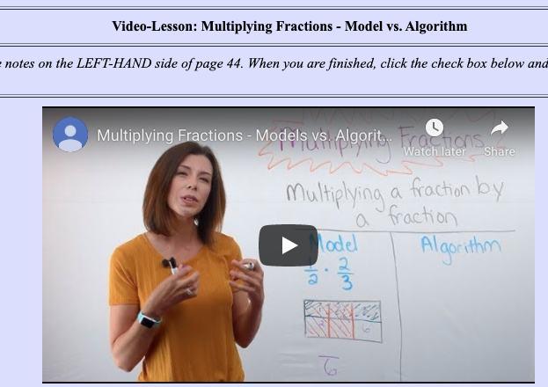
You Try – Multiplying a Fraction and a Fraction – Patty Paper
I gave you extra pieces of patty paper just in case you make a mistake ☺
Joe is very picky about pizza.
He asks for pepperoni to be on ½ the pizza and mushrooms on ¾ of the pepperoni side.
What portion of the entire pizza has both pepperoni and mushrooms?
You will upload this to Canvas!
Need help?? Re-watch the video in the Multiplication Video Assignment!

Slide 14

You Try – Multiplying a Fraction and a Fraction – Patty Paper
One piece of patty paper represents the original pizza.
Fold the paper into halves and shade 1 copy of ½
This represents the pepperoni side (Draw pepperonis on it :).
Fold your paper so only the shaded part is showing.
Fold your paper to illustrate we are putting mushrooms on ¾ of the pepperoni half.
Use a darker color to shade this amount.
Now we want to go back & see this dark shaded area in terms of the entire pizza
Rename the dark shaded area using the entire patty paper as our unit.
Now write out the multiplication sentence
Remember, I gave you extra pieces of patty paper so you can practice!
Notes:
Here is where the meaning of the unit is so important.
Some students might say they ate 1/3 of the original tray. We have to try to move them towards recognizing that the 1/3 was using the leftover as the unit. We want to go back and use the original tray as the unit.
1/3 of the leftovers is actually ¼ of the original tray.

Slide 15
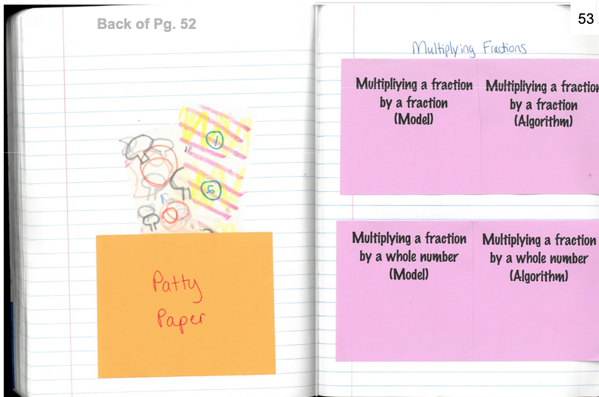
Make a pocket!
Make a pocket (out of the extra colored paper I gave you) for your patty papers to go in once they are folded!
L.H. side of pg. 53!

Slide 16
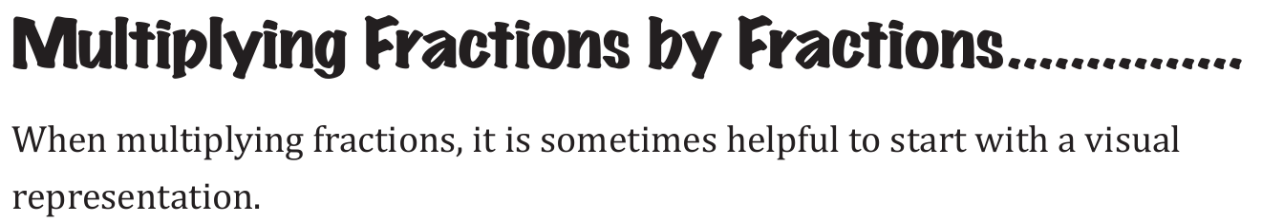
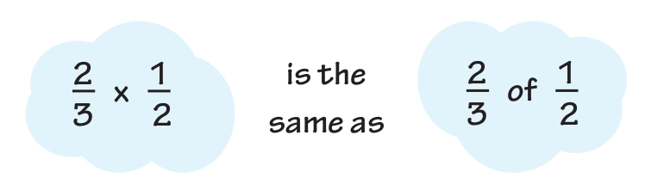
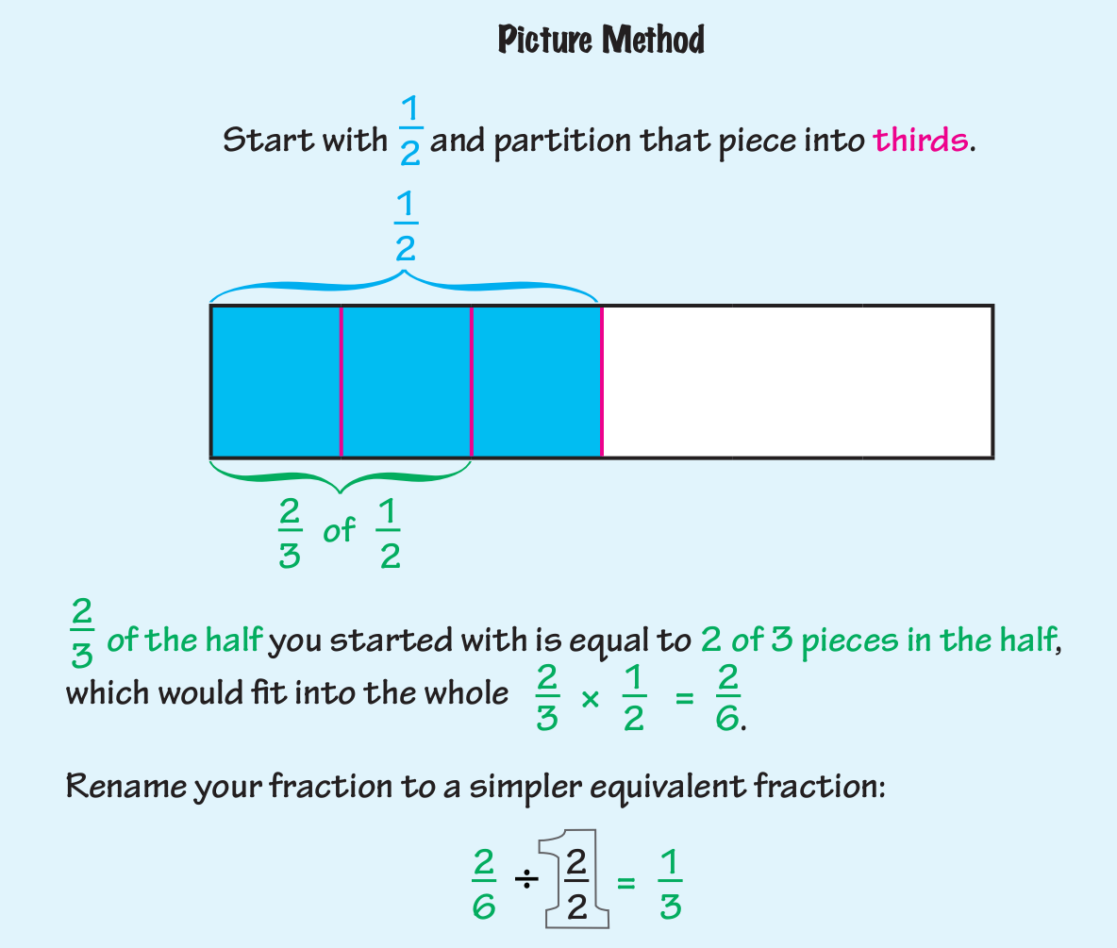
From your text book!

Slide 17
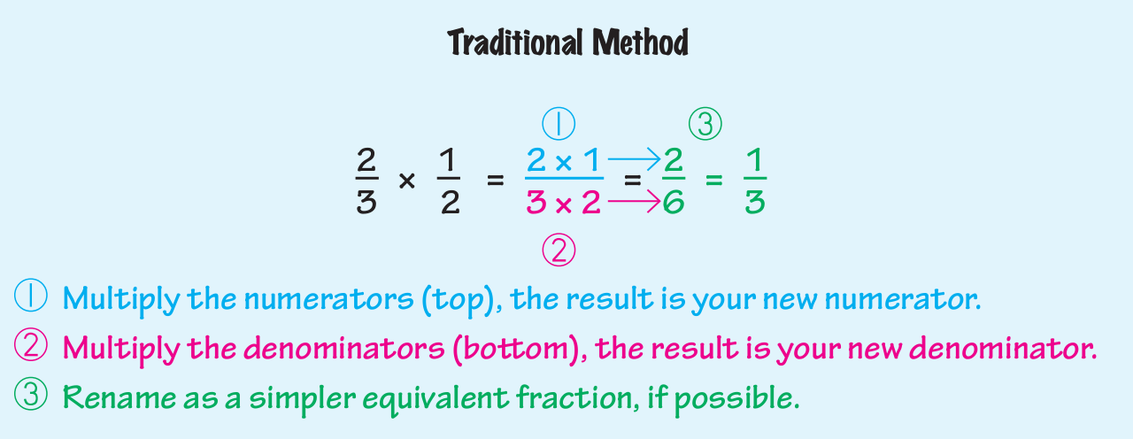

Slide 18
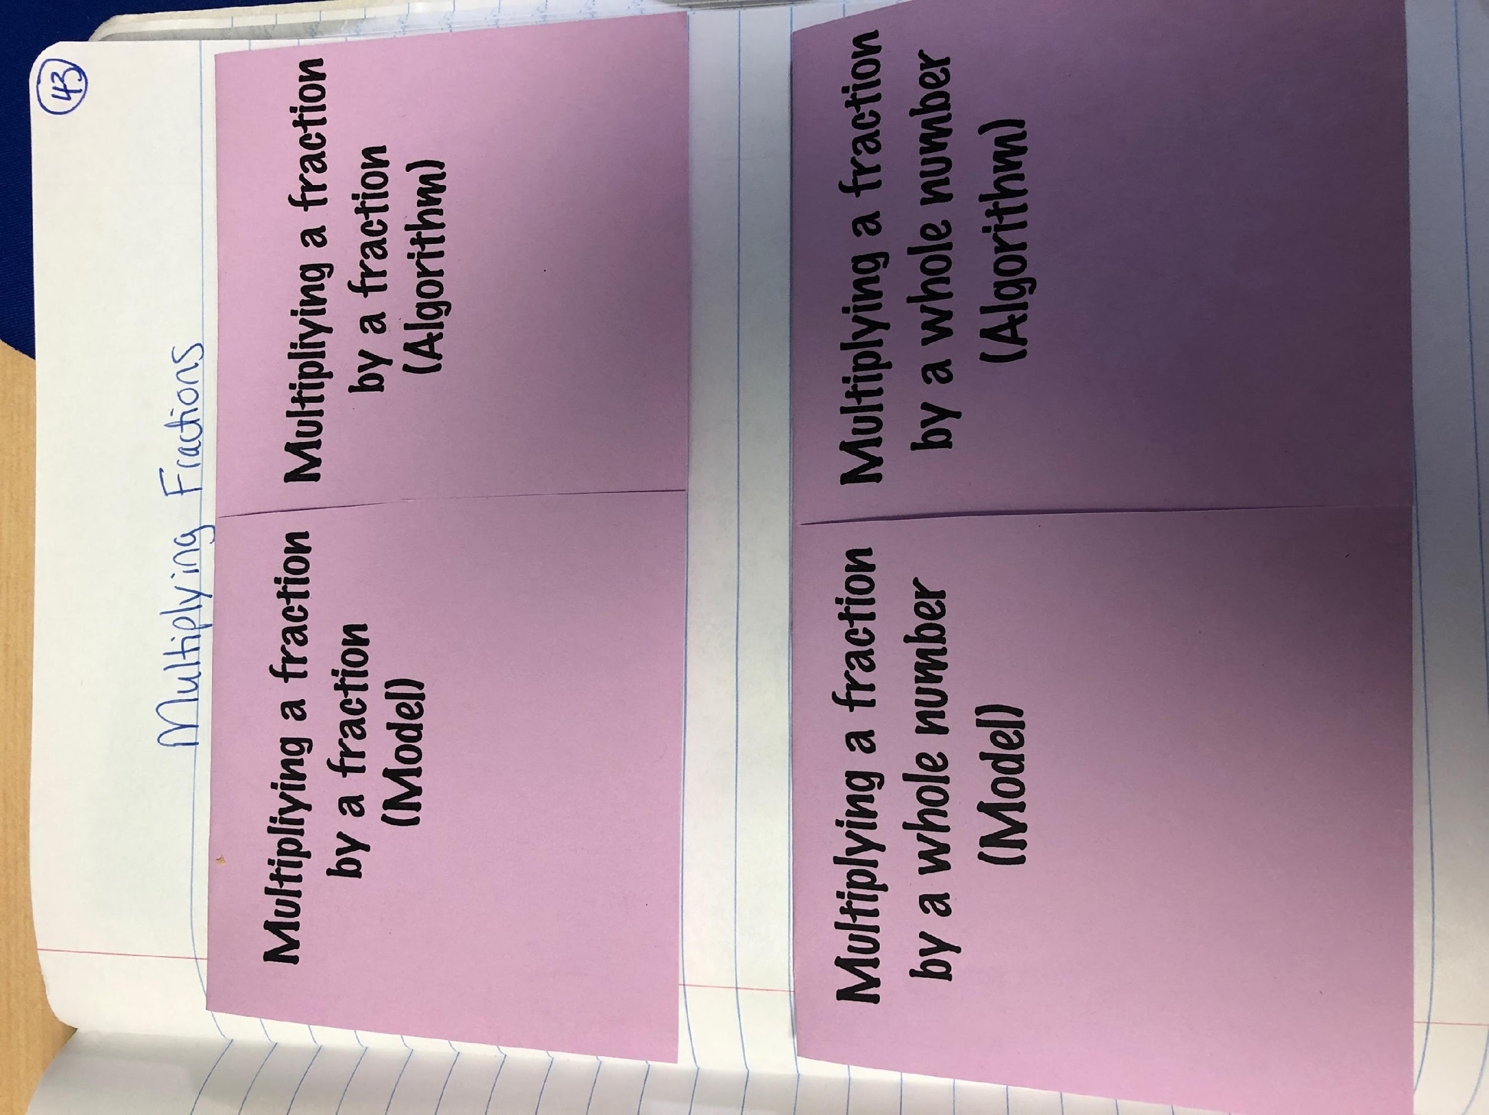
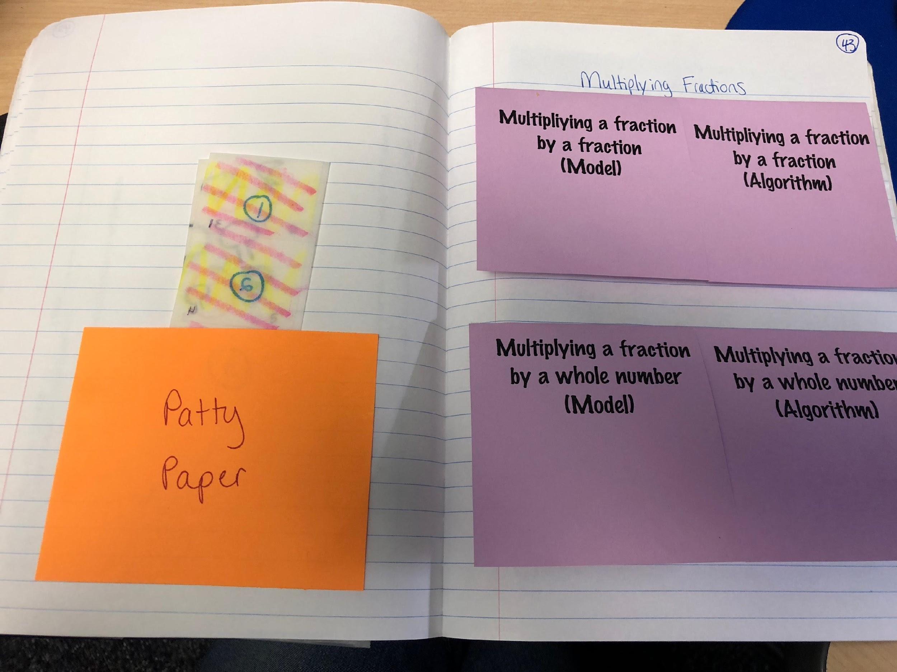
Let’s check! Foldable Time!! (Right-Hand side of Pg 53)
53

Slide 19
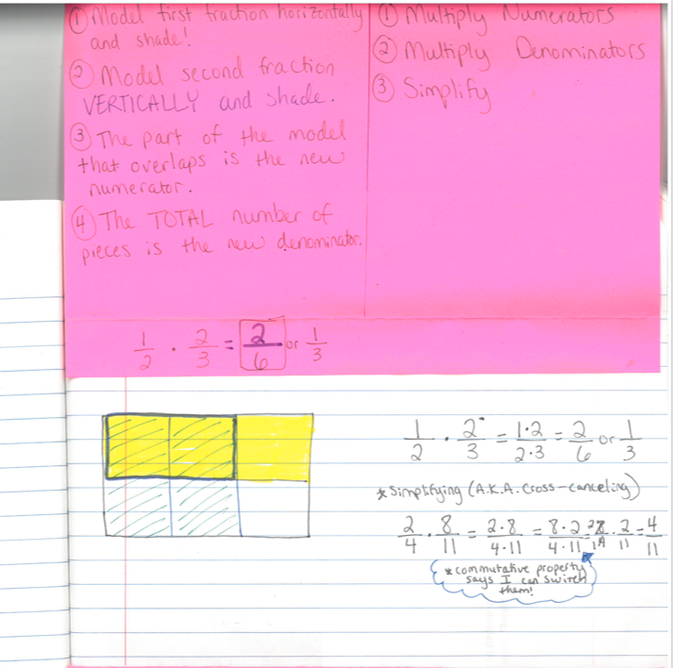
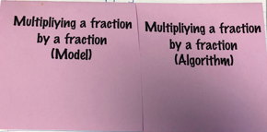
Foldable Time!! Notes Under the TOP!

Slide 20
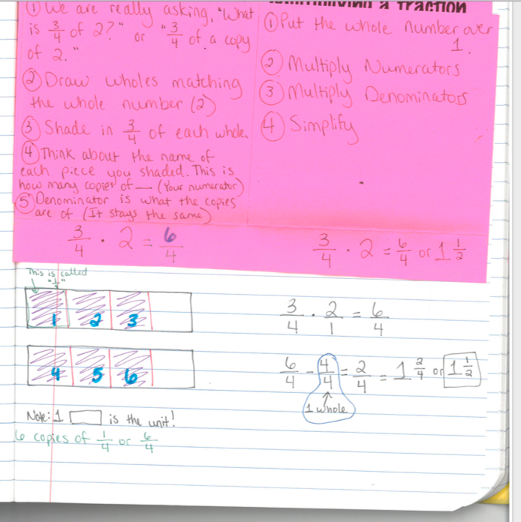
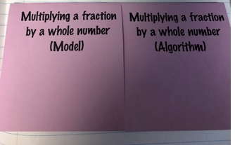
Foldable Time!! Notes Under the BOTTOM!

Slide 21
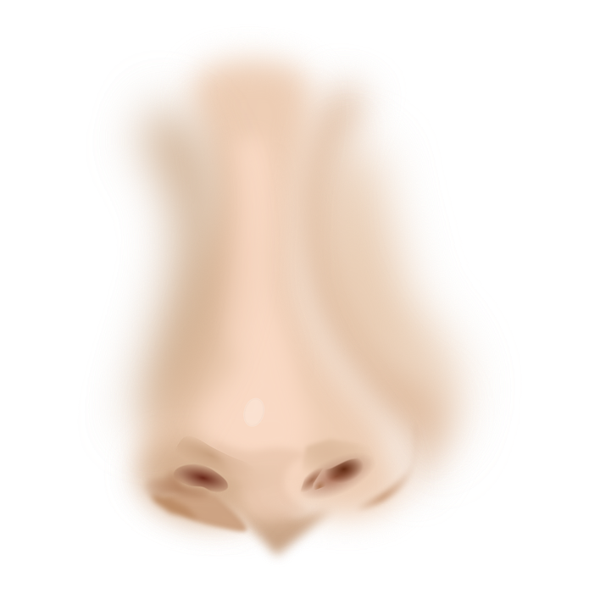

Brain Break!
Ear-Nose-Switcheroo
Touch your LEFT ear with your RIGHT hand.
At the same time, touch your nose with your LEFT hand.
Now, SWITCH! Touch your RIGHT ear with your LEFT hand and at the same time, touch your nose with your RIGHT hand.
Switch back and forth a couple of times.
Now take a deep breath and let it all go!

Slide 22
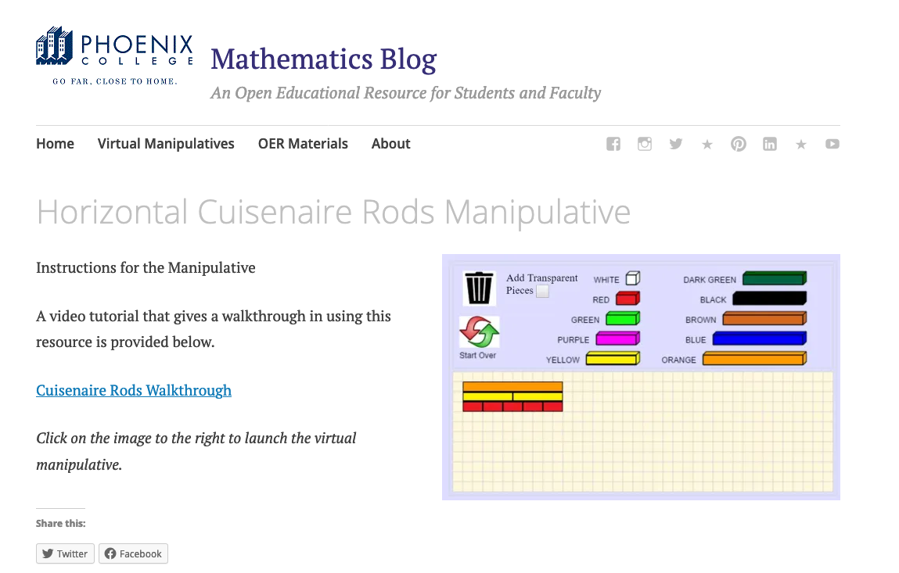
Have open the cuisenaire rods...
https://s3-us-west-2.amazonaws.com/oervm/cuisenairerods/CuisinartRodsHoriz.html

Slide 23
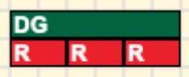
Example - Division with Cuisenaire Rods
When we divide one number by another, we are really asking the question,
“How many copies of the second number are in the first?”
For example, when we ask what is 6 divided by 2, we are really asking, “How many copies of 2 are in 6?”
If you let the Dark Green rod equal 6 and the red rod equal 2, you can see the 3 red rods are equal in length of the Dark Green rod.
https://s3-us-west-2.amazonaws.com/oervm/cuisenairerods/CuisinartRodsHoriz.html
Notes:
Do the first demonstration and then hand out the worksheet. Students have a tendency to read ahead and will miss the first demonstration.

Slide 24
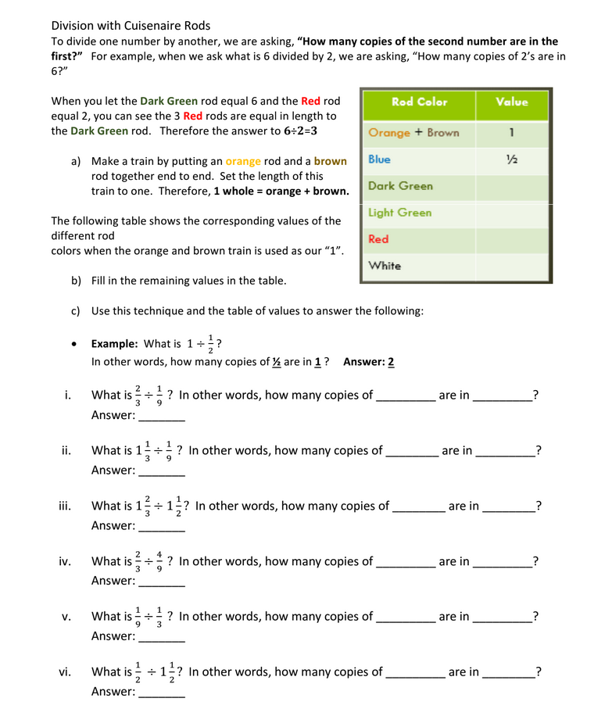
Division with Cuisenaire Rods
Yours is light blue!
Make a train by putting an orange rod and a brown rod together end to end.
Set the length of this train to one.
The following table shows the corresponding values of the different rod colors when the orange and brown together, end to end, is used as our “1”.
Rod Color | Value
Orange + Brown | 1
Blue | ½
Dark Green
Light Green
Red
White

Slide 25


Division with Cuisenaire Rods
Yours is light blue!
What is dark green if orange+brown is the unit?
Rod Color | Value
Orange + Brown | 1
Blue | ½
Dark Green
Light Green
Red
White
I see that 3 dark greens make up the unit. Therefore, one dark green would be ⅓.
1/3

Slide 26
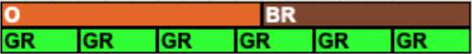

Division with Cuisenaire Rods
Yours is light blue!
You try for light green!
I see that 6 light greens make up the unit. Therefore, one light green would be ⅙.
Rod Color | Value
Orange + Brown | 1
Blue | ½
Dark Green
Light Green
Red
White
1/3
1/6

Slide 27
Division with Cuisenaire Rods
Yours is light blue!
Finish the rest!
Check your answers with mine!
Rod Color | Value
Orange + Brown | 1
Blue | ½
Dark Green
Light Green
Red
White
1/3
1/6
1/9
1/18

Slide 28
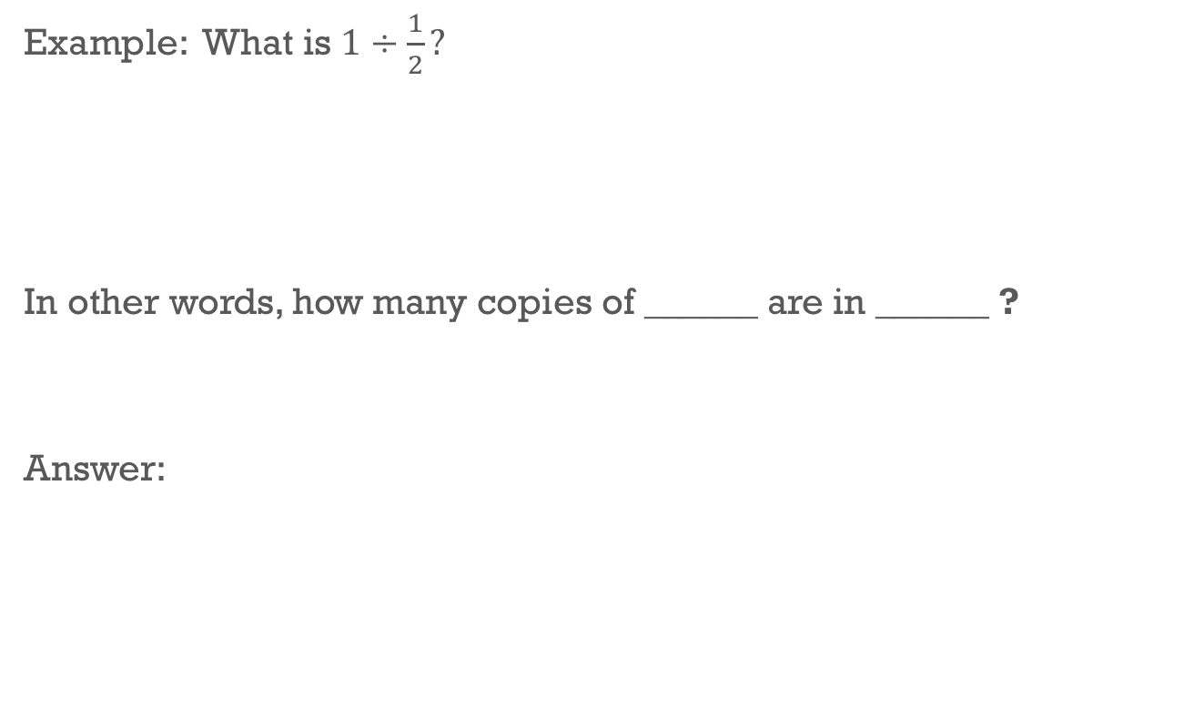
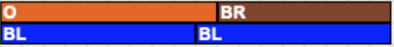
Example - Division with Cuisenaire Rods
Build the model in the V.M.! 1 is your unit (orange+brown) and ½ is blue!
= 2
1/2
1
I see that that there are TWO copies of the blue rod in the unit. Therefore, my answers is 2.
Notes:
If the students are already familiar with this table of values, you could fill in the rod values ahead of time, or you could have the students fill them in quickly as review.
Be sure that the students understand which numbers fill in which blanks. Students will seem to get it when speaking, but will fill in the blanks backwards.
Students will get confused the first time they encounter a problem where the answer is not a whole number. Help them see that they need to find the fraction of a copy.

Slide 29
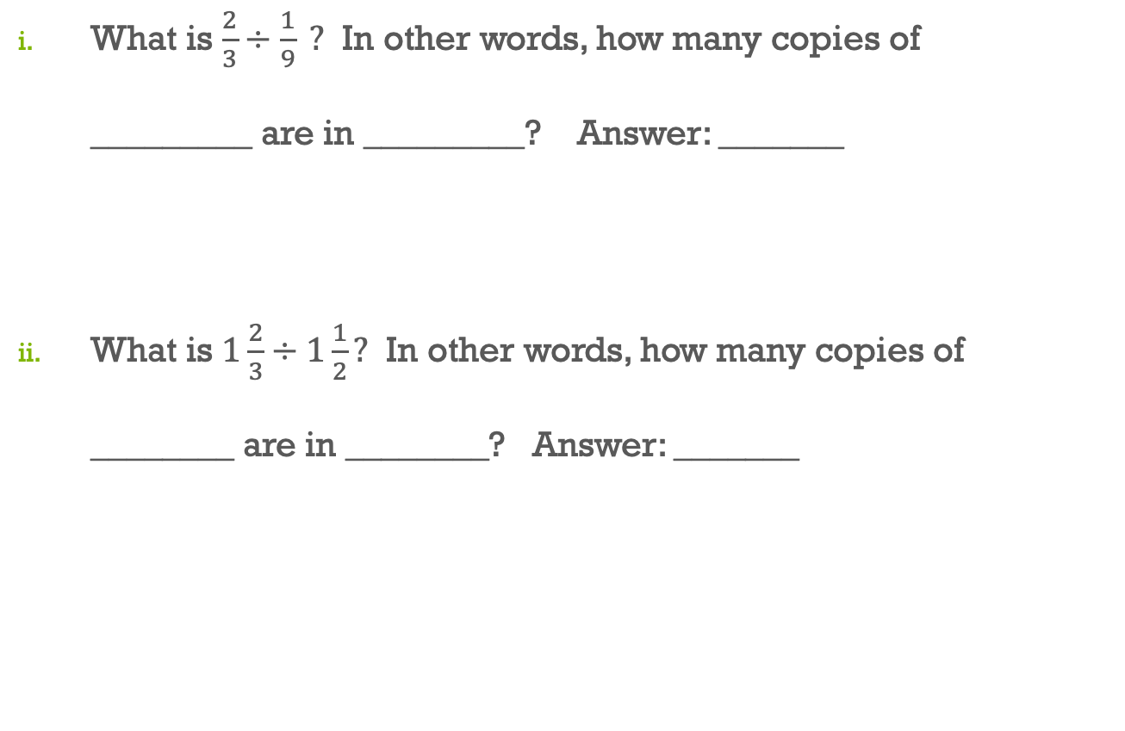

Let’s try another one...
Fill this in first!
1/9
2/3
6
There are 9 copies of red in the dark green.
Therefore, there are 6 copies of 1/9 in ⅔.
Notes:
If the students are already familiar with this table of values, you could fill in the rod values ahead of time, or you could have the students fill them in quickly as review.
Be sure that the students understand which numbers fill in which blanks. Students will seem to get it when speaking, but will fill in the blanks backwards.
Students will get confused the first time they encounter a problem where the answer is not a whole number. Help them see that they need to find the fraction of a copy.

Slide 30

Finish the rest!
You are uploading this to Canvas!
Still confused? Reach out to another classmate (or text Pamela!)!
Notes:
If the students are already familiar with this table of values, you could fill in the rod values ahead of time, or you could have the students fill them in quickly as review.
Be sure that the students understand which numbers fill in which blanks. Students will seem to get it when speaking, but will fill in the blanks backwards.
Students will get confused the first time they encounter a problem where the answer is not a whole number. Help them see that they need to find the fraction of a copy.

Slide 31
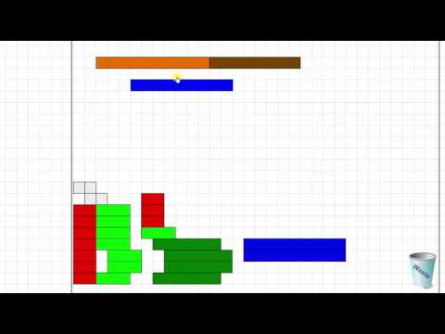
Still Confused?
Before you keep going (and watch this video), make sure you have PERSISTED in problem solving! It doesn’t help if I just give you the answers. This will not make you learn… :)
Notes:
If the students are already familiar with this table of values, you could fill in the rod values ahead of time, or you could have the students fill them in quickly as review.
Be sure that the students understand which numbers fill in which blanks. Students will seem to get it when speaking, but will fill in the blanks backwards.
Students will get confused the first time they encounter a problem where the answer is not a whole number. Help them see that they need to find the fraction of a copy.

Slide 32
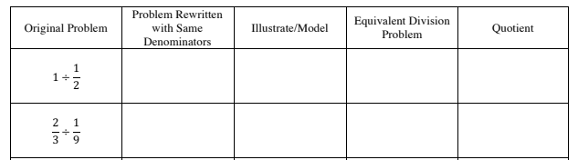
Let’s do something different!
A different algorithm for division of fractions:
Rewrite both fractions so that they have the same denominator.
Divide the numerators and divide the denominators (always a 1). The answer will be the quotient from the numerators.
“Developing the Common Denominator Fraction Division Algorithm,” MTMS, November 2012.

Slide 33
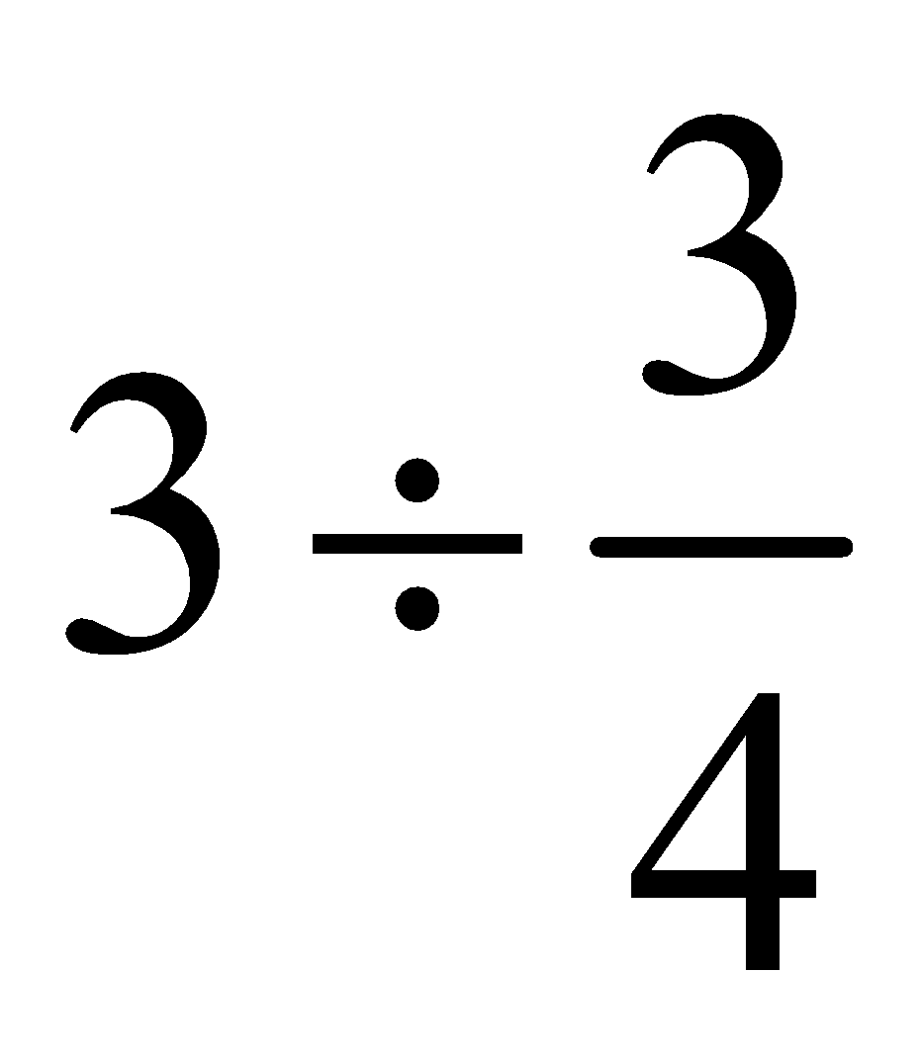
Fraction Strips
How could we restate the question that is being asked by the these symbols?
How could we use fraction strips to concretely depict the problem?
What is our “dilemma” as we reason together?

Slide 34
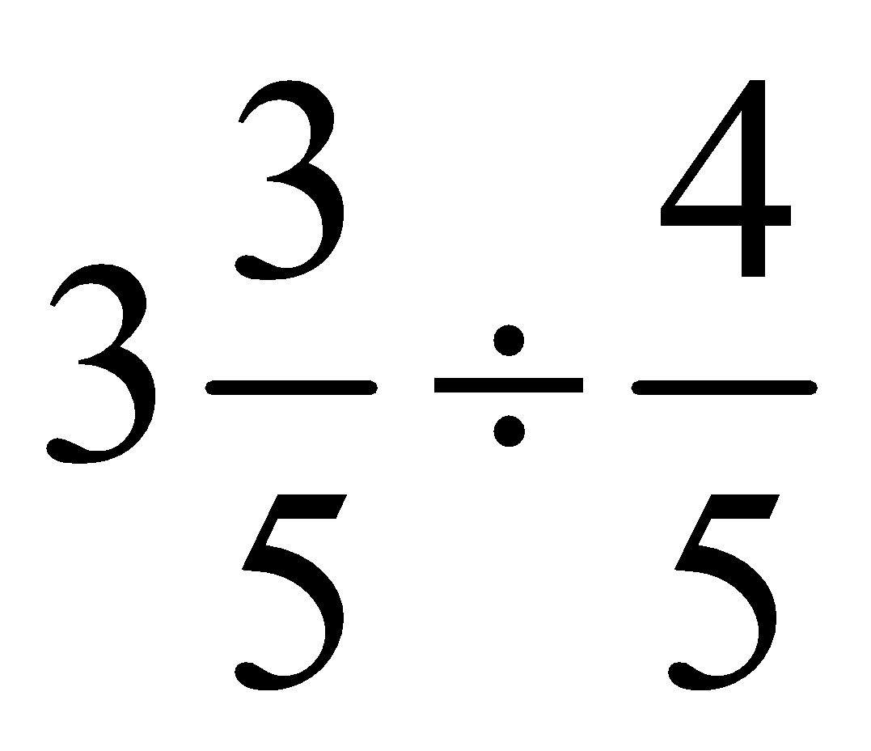
Fraction Strips
What question is being asked by this number sentence?

Slide 35
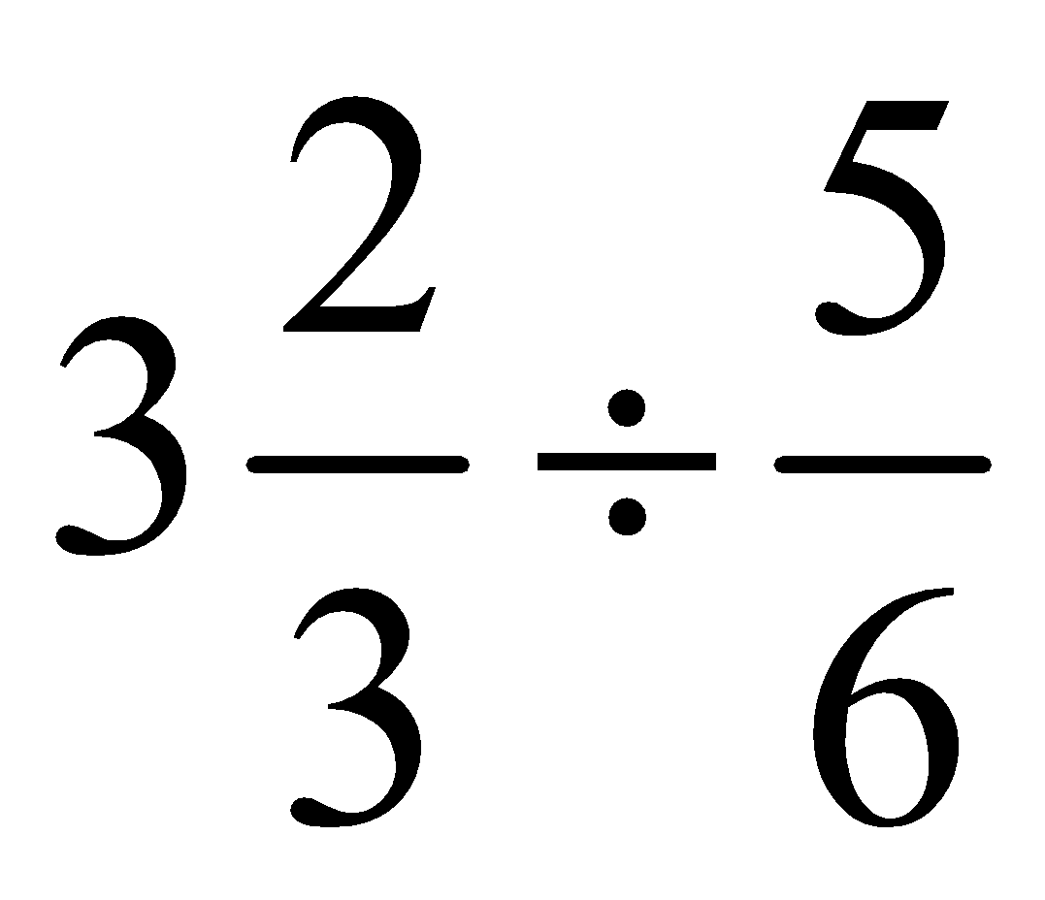
Explain using the language of the manipulative and mathematics.

Slide 36
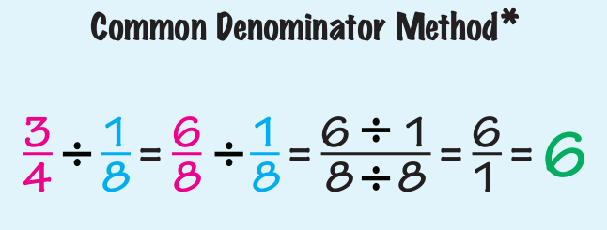
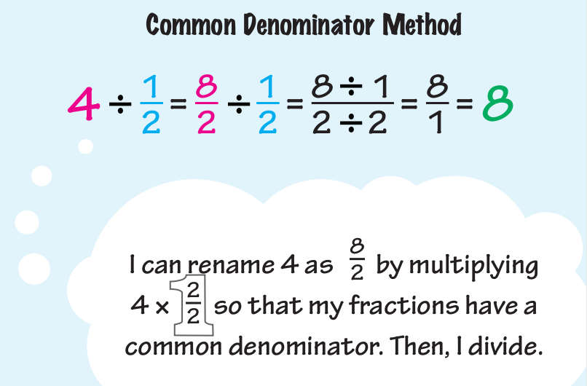
Notes:
Demonstrate how to change the original problems into problems rewritten such that the numbers are of the same type. Start by finding the correct rods to represent the numbers in the original problem. Then, trade the rods so that both numbers are represented with the same color rod. Finally point out that now that the rods are the same color, the color is irrelevant. Fill in the table as you work through the first couple of rows.
The goal here is to have the students realize that once we have the numbers rewritten in the same “type,” the type becomes irrelevant and is therefore ignored. For fractions, the denominator is the “type,” hence; students should see the need for common denominators. Once the fractions are written with common denominators, they are of the same type and therefore the denominator can be ignored. Just as the color of the rod did not matter in the initial examples “color” of the fraction does not affect the solution to the division problem.
Note: Help the students to see that when they get to the problems with mixed numbers, they will first need to convert to common fraction form.
Note: The “Equivalent Problem” column shows a multiplicative comparison.

Slide 37
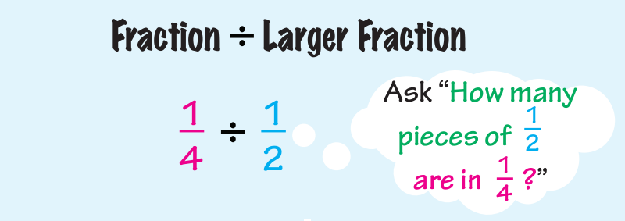
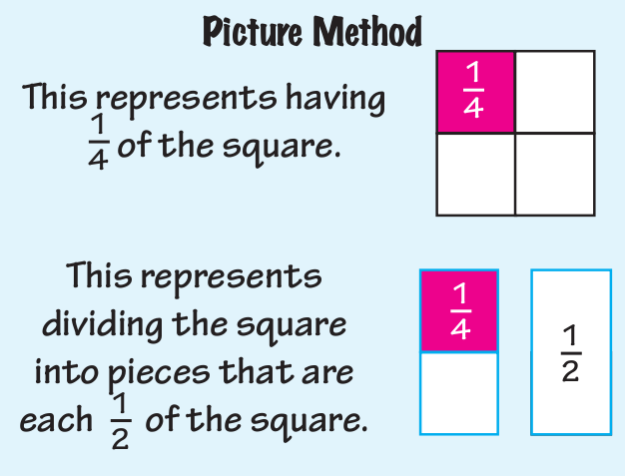
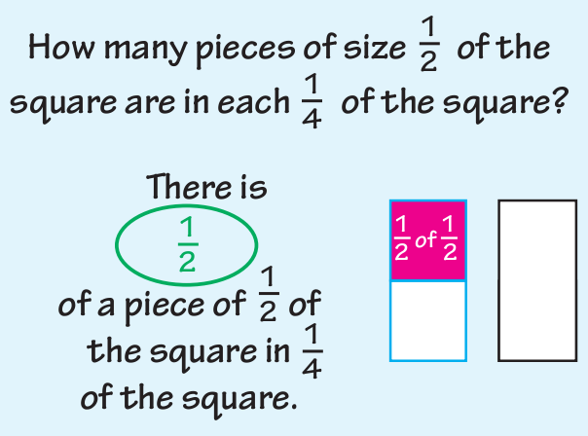

Slide 38
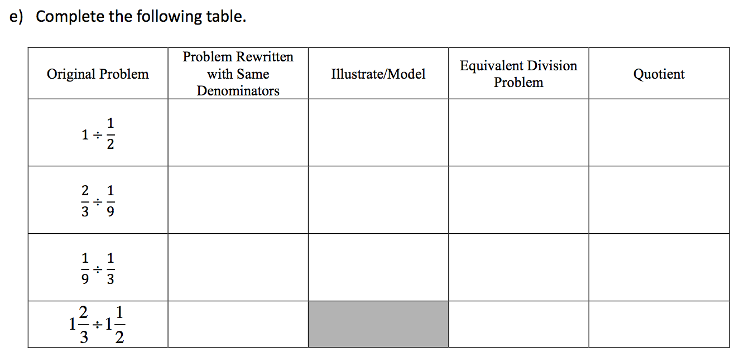
Finish for homework!
Notes:
Demonstrate how to change the original problems into problems rewritten such that the numbers are of the same type. Start by finding the correct rods to represent the numbers in the original problem. Then, trade the rods so that both numbers are represented with the same color rod. Finally point out that now that the rods are the same color, the color is irrelevant. Fill in the table as you work through the first couple of rows.
The goal here is to have the students realize that once we have the numbers rewritten in the same “type,” the type becomes irrelevant and is therefore ignored. For fractions, the denominator is the “type,” hence; students should see the need for common denominators. Once the fractions are written with common denominators, they are of the same type and therefore the denominator can be ignored. Just as the color of the rod did not matter in the initial examples “color” of the fraction does not affect the solution to the division problem.
Note: Help the students to see that when they get to the problems with mixed numbers, they will first need to convert to common fraction form.
Note: The “Equivalent Problem” column shows a multiplicative comparison.

Slide 39
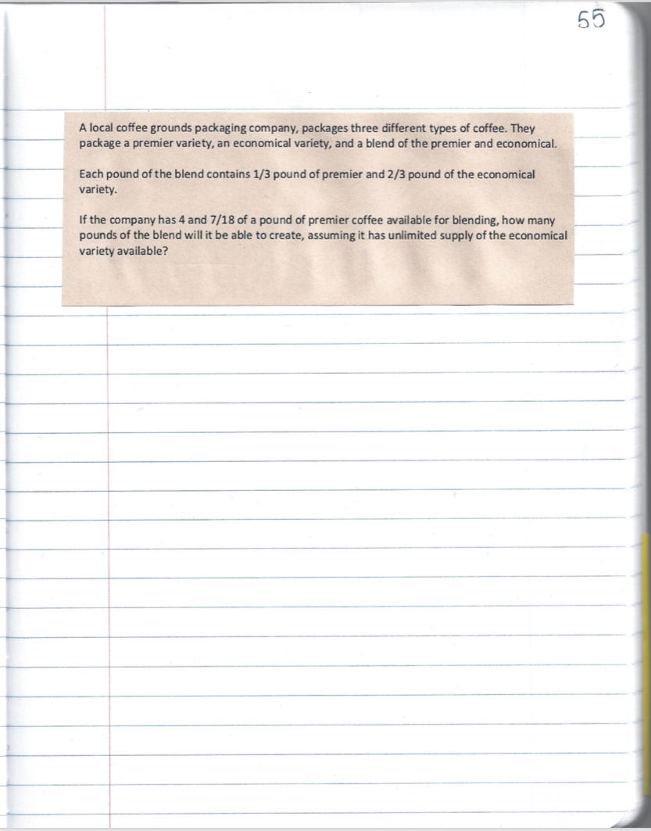
Coffee Problem
WORK INDIVIDUALLY!
Read the following problem.
Do Step 1 and 2 of the Polya 4 step method.
DO NOT SOLVE THE PROBLEM!

Slide 40
Coffee Problem
Think, Pair, Share about the coffee problem. Discussing steps 1 and 2 of the problem solving method. Do not solve the problem. Just answer the following questions.
What is happening in the problem?
What strategy will you use to solve the problem?
What mathematical operation do you think you will use to solve the problem?
Share strategies with the class.
We are not finding an answer to the coffee problem right now. You will complete and upload this in Canvas and discuss it at a later date.

Slide 41

Now….
Solve the problem :)
NOTE: If you think this problem is going to be solved with a proportion, you may want to try drawing a picture.

Slide 42
How about a word problem?
R.H. side of Page 46
A group of mothers makes costumes for a children’s theatre. They are making collars for each costume. Each of the collars requires PART of a yard of fabric. The shaded part below shows the fraction of a yard needed for 1 collar. How many yards of fabric will they need to make 7 collars?
NOTE: Draw a picture to represent your thinking!!
Are you thinking in terms of copies of???
Don’t go to the next slide until you are done!

Slide 43
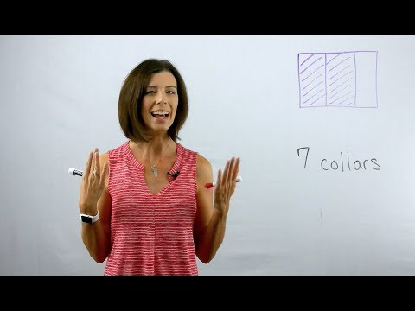
Watch this to check your answer

Slide 44
More word problems...
R.H. side of Page 46
Celia first put ¾ cup of butter in her Alfredo sauce. Then she added another ⅓ of a cup. How much butter was in her Alfredo sauce?
Draw a picture to help you solve the problem. (HINT: Use your fraction strips to help!)
Be sure to not what each fraction represents; what is it a fraction of?

Slide 45


Here’s another...
R.H. side of Page 46
Ken got of a ton of gravel, even though he ordered of a ton. What fraction of his order did Ken get?
Draw a picture to help you solve the problem.
Be sure to note what each fraction represents.

Slide 46

You try!
R.H. side of Page 46
You want to make a recipe that calls for cup of butter, but you only have cup of butter left. What fraction of the recipe can you make (assuming you have enough of the other ingredients)?
Draw a picture to help you solve the problem.
Be sure to note what each fraction represents.

Slide 47

Heads-up!
Test 2 practice is now posted.
There are TWO practice tests. One is in MOER and one is a pdf that you can print out and write on.
Any question from these is fair game and would be something you may see on the test.
You must open (at least for a second) both of these in order for Test 2 to open the week of 4/19.
Please reach out if you have any questions!

Slide 48
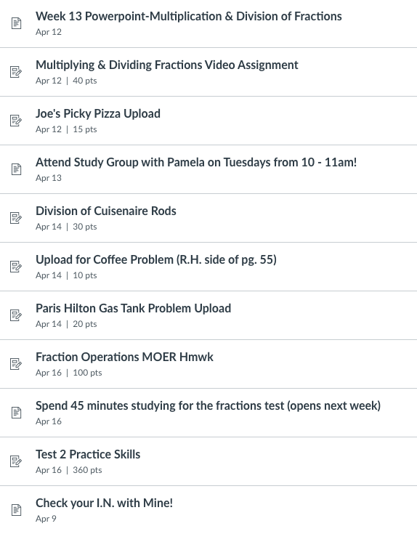
Due Dates

